Slide 1
GO Team Meeting
Dunbar Elementary School
April 17, 2025

Slide 2
Agenda
Call to Order
Roll Call; Establish Quorum
Action Items (add items as needed)
  Approval of Agenda
  Approval of Previous Minutes:
  Additional Action Item 1 (if needed):
Discussion Items (add items as needed)
  2025 Spring MAPS results
  Needs Assessment
Information Items (add items as needed)
  Principal’s Report
    2024-2025 Family Engagement and/or Partnership Highlights
  Cluster Advisory Team Report – 3/24/2025
  GO Team Elections
Announcements (add items as needed)
Public Comment (if applicable)
Adjournment

Slide 3

2025 Spring
MAPS Results
Data Points to Consider
Spring Results
Fall to Spring Comparison
  Literacy
  Numeracy

Slide 4
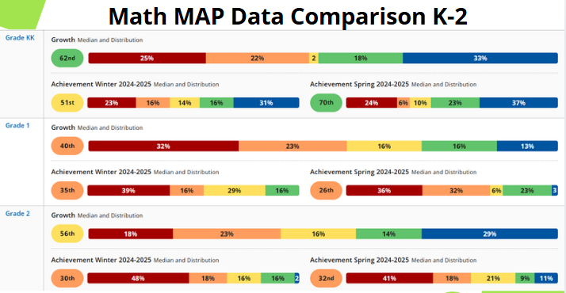

Slide 5
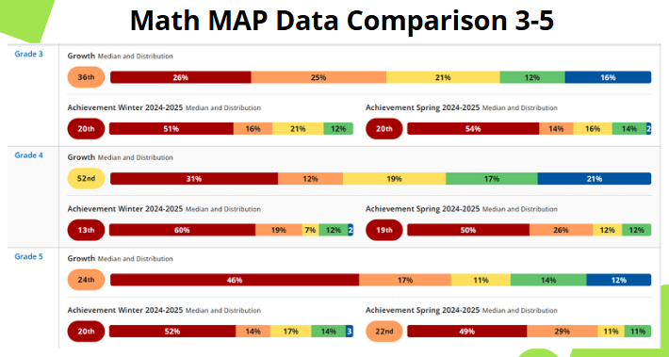

Slide 6
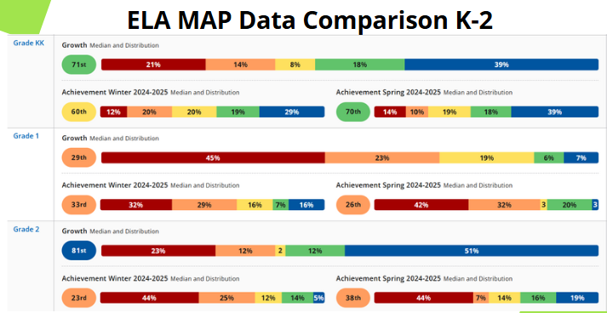

Slide 7
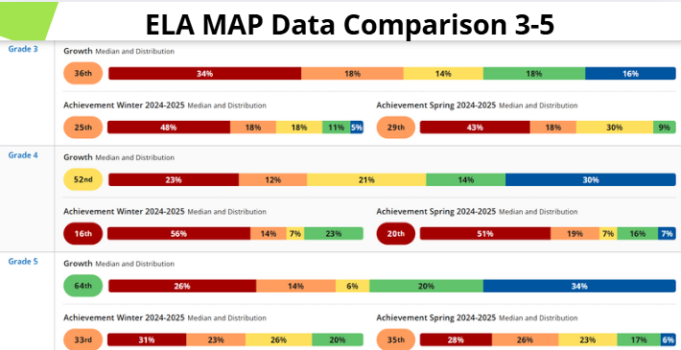

Slide 8

The percentage of students scoring in red on the schoolwide data comparison have decreased in both content areas.
The percentage of students scoring in developing and above on the school wide data comparison has increased.
Kindergarten data has a significant increase of 10% on the distinguished level in ELA.
Second grade has a 14% increase in distinguish in ELA.
On average the overall percentile of students has increased with the exception of 1st grade.
ELA Coaches are pushing in to assist with 3rd grade and 4th grade small groups.
Math Coach and specialists are pushing in to assist with 3rd-5th grade small groups.

Slide 9
Needs Assessment:
Guiding Questions
What does this data tell us?
What good news is there to celebrate?
Where are growth opportunities?
What trends do we see in the data?

Slide 10
ACTIVITY: Strengths & Opportunities
Based on your discussion about the school data, determine point of strength and opportunities for improvement and summarize them below.
Strengths | Opportunities
Group Discussion

Slide 11
Needs Assessment:
Based on your responses for strengths and opportunities, what must be true for (INSERT SCHOOL) to Achieve Excellence:
 | Need
1
2
3

Slide 12
Next Steps
Principals will spend the summer preparing for SY2025-26
Schools will begin meeting after July 1 to organize their GO Teams for the year
During the first business meeting in Fall 2025, principal and GO Teams will review strategic priorities and metrics for the year

Slide 13
Information Items

Slide 14

Principal’s Report

Slide 15
Partnerships | Description
Norfolk Southern | Lighthouse
Earn2Give | D9 Organizations
AVLF | Arnold, Golden,Mcgregory Law Firm
Women Ministry | Alston & Byrd Law Firm
Morehouse School of Medicine | Atlanta Food Bank
Spelman Spelreads
Curriculum & Associates
Marriott Hotels
Scholastic
Everybody Wins
SafeRoutes for Schools

Slide 16


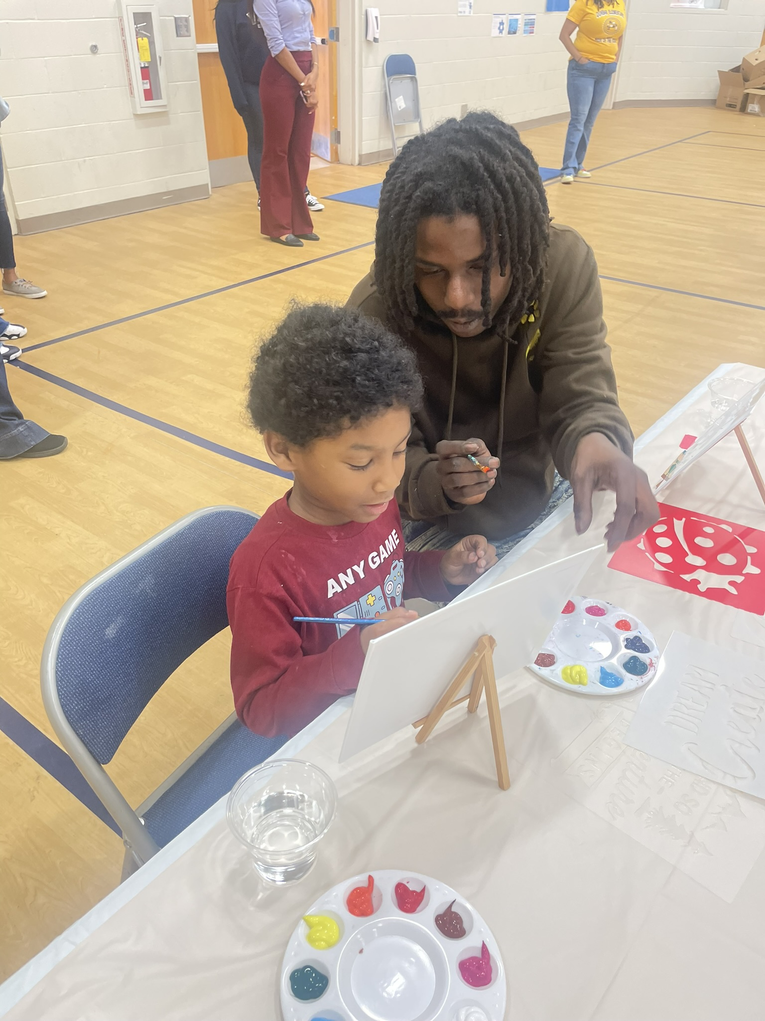
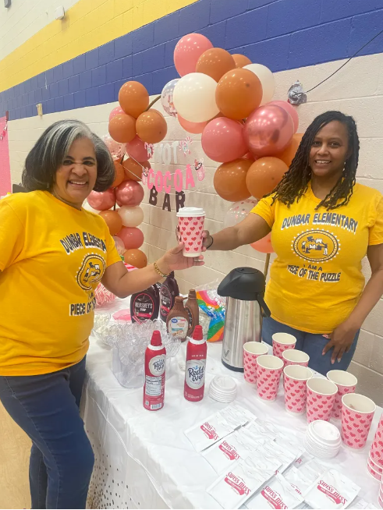
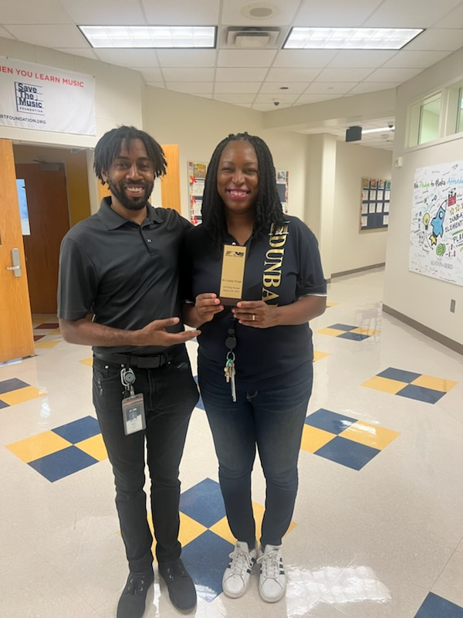


Slide 17
Important Dates
Spirit Week for Testing
10 for Win April 25th- May 14th
April 25- Pep Rally
GMAS Testing April 28th- May 14th
Field Day with School Nutrition and Friends May 23rd

Slide 18
Additional Information Items
Cluster Advisory Team Report
GO Team Elections
  Find candidates at apsstrongschools.com
  Vote APRIL 16-25
  Households are sent a unique link based upon information in Infinite Campus
  School Staff will be sent a link to their APS email address

Slide 19

Announcements
GO Team Members
  Complete your end of year surveys (AVAILABLE NOW! Check your email for the link)
    Principal Feedback Survey
    GO Team Satisfaction Survey
  Complete your required trainings ASAP
    Contact the GO Team Office with any questions

Slide 20


